Slide 1
Investment Strategy: Building and Optimizing
Multi-Factor Volatility Timing Models Using Machine Learning
Fang Cao, Haozhi Chen, Ziyu Lin, Yuqing Liu,
Shuyue Shen, Xizhi Wang
Notes:
The investment strategy of our team is…

Slide 2
Overview
Basic Idea:
In this model, we explored the relationship between multiple factors and payoff of portfolios. By adapting the machine learning algorithm, our team seek to find the signs to enter the market and the time point to exit the market
FACTOR PRETEST
LSTM
OUTCOME
FUTURE
LSTM and CNN produce a linear return model for the selected stock.
Result varies by randomness
Machines learning improves result
Decision timing affect results
Improve Accuracy
Unite
Models
Less
Reliance on initial
position
The process of factor pretest is meant to dealing with faulty data such as missing data or extreme data.
AdaBoost, Decision-Tree, LGBM,
MLP, SVM, Random Forest
The combination of 6 machine learning models are used to classify returns related to market.
Notes:
Firstly, I want to walk you through the basic strategies and approaches we adapted for the project.

Slide 3
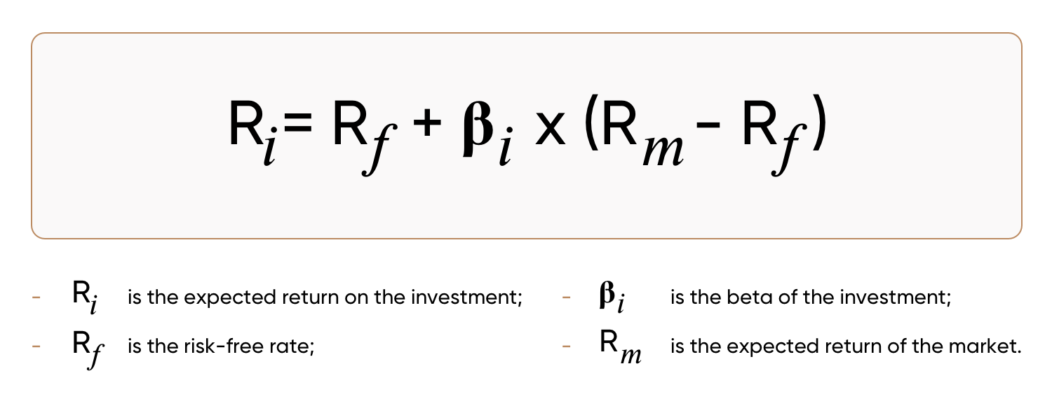
INTRODUCTION
From CAPM to APT
Data collection and standardization
Dropping and filling None cells filtered extreme values with
medians and ranges Z-score ranking PCA transformation
Backtesting, IC/IR
The information coefficient (IC) is a measure used to evaluate the skill of an investment analyst or an active portfolio manager.
Factor filtration and weighting
Filtered the original factors and transformed in to weighed binary factors.
Model optimization
Adapted 6 different machine learning strategies to perform an optimized portfolio.

Slide 4
Multi-factor model
Factor evaluation
Standardization and preprocessing
Investment signal design
Strategy design
Portfolio simulation
Notes:
For the multi factor model part, our team conducted....

Slide 5
Factors
Macroeconomic factors
Interest rate, oil price, gas price, Consumer Price Index
Volume impulse ratio, beta of volume, turnover rate, volume-price correlation factor
Value premium (fama french), gross profit growth, Operating Cash Flow growth, ROE growth, annual cash growth, cash/market cap, dividend yield
T-21 / T-63 / T-126 / T-252 closing price
Gross margin, profit margin, gross profit to asset, rolling ROE/ROA, ROIC, cashflow/market size, net income, long-term debt/working capital, net gearing ratio, earning power ratio
Size factors
Growth factors
Momentum factors
Gross profitability factors
Notes:
After reading relevant articles, we found a tons of factors and downloaded their data from Bloomberg. We found that there are five main groups of factors.

Slide 6
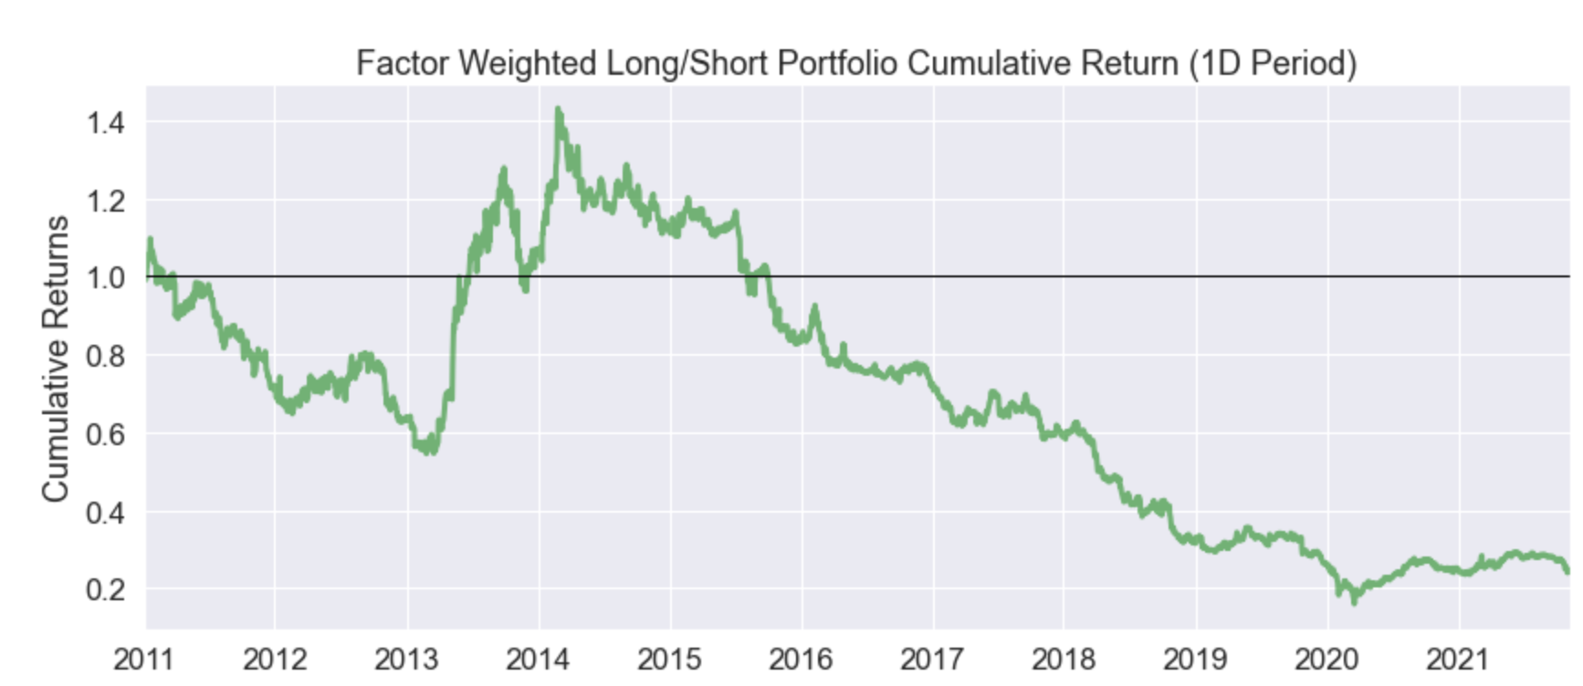
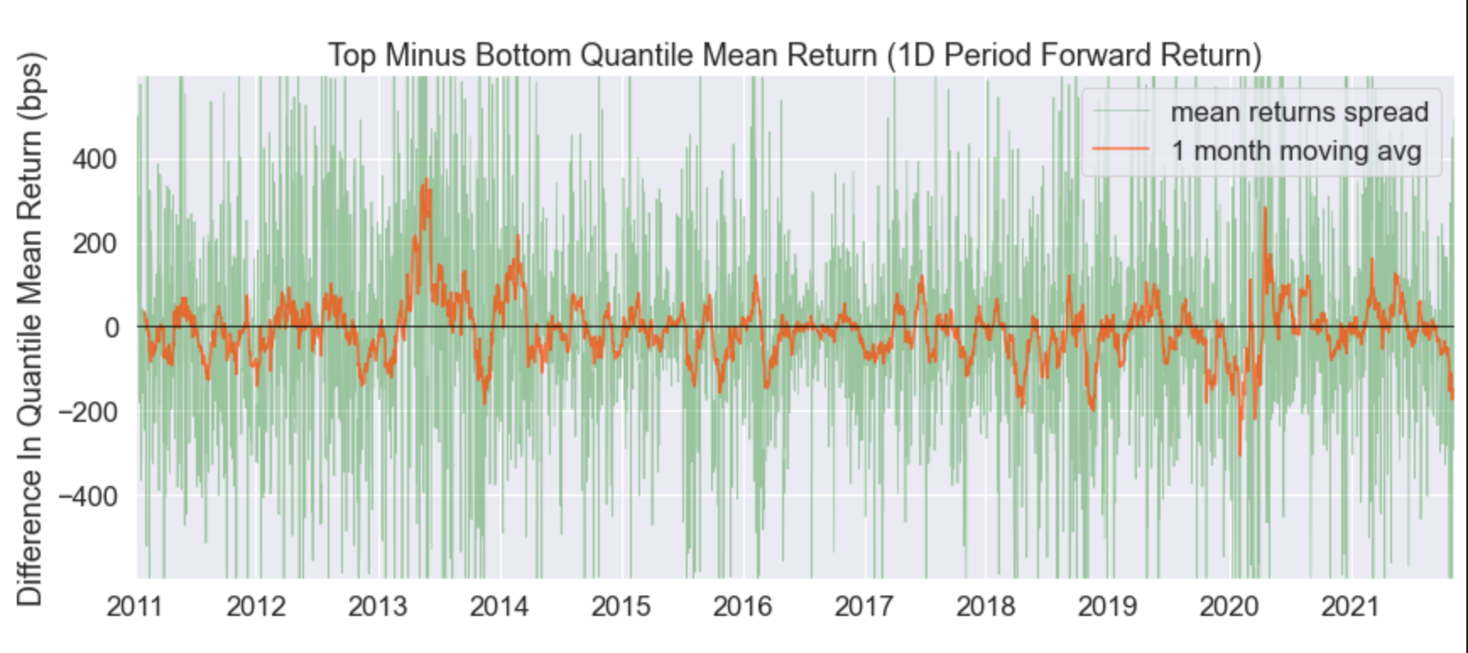
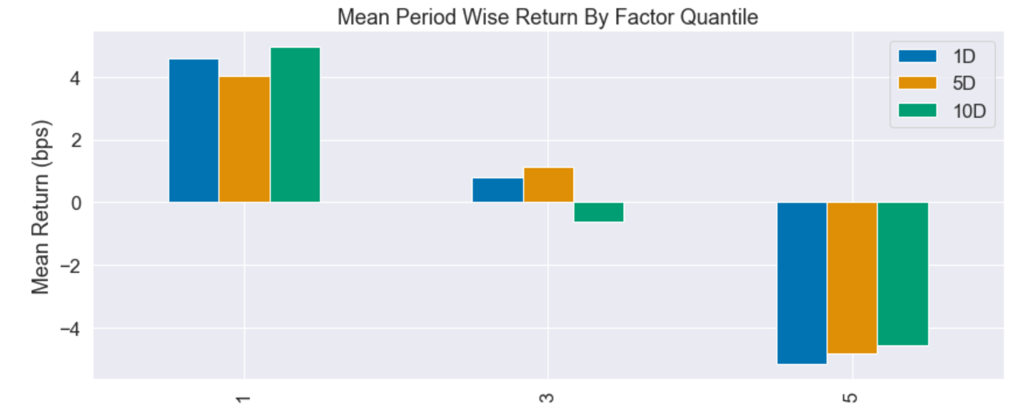
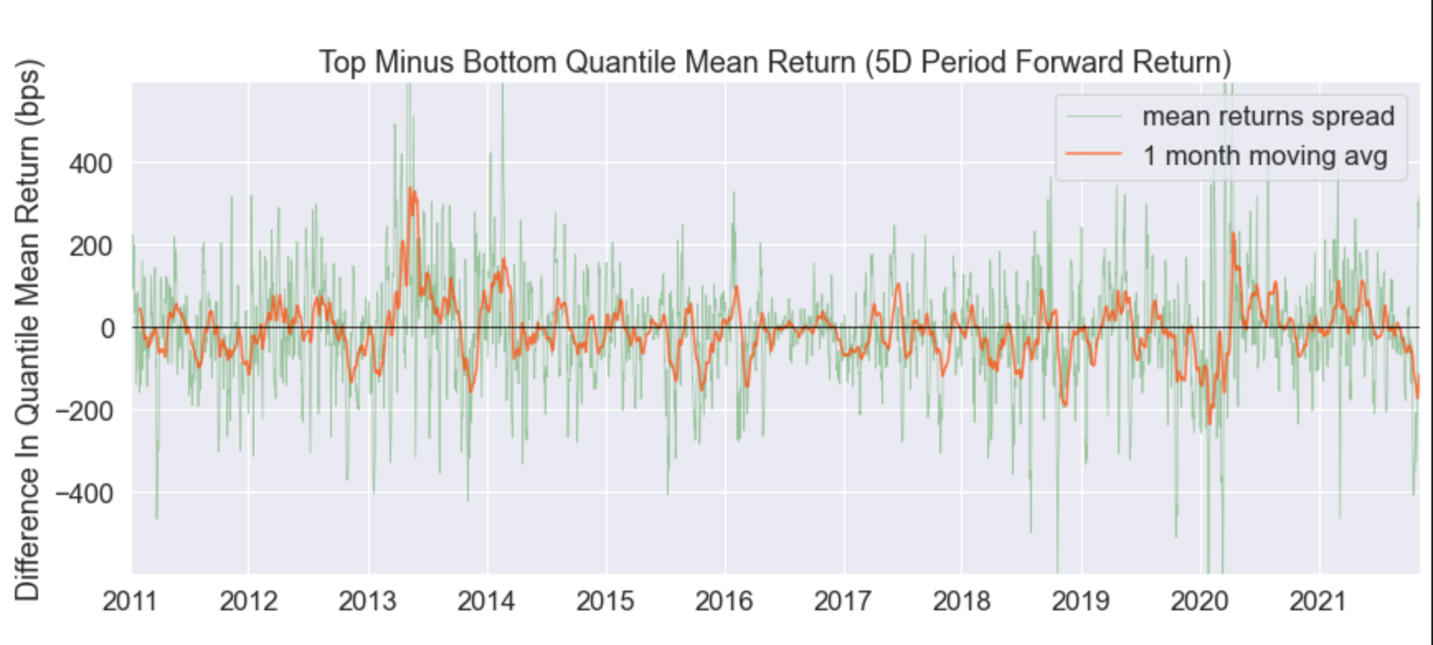
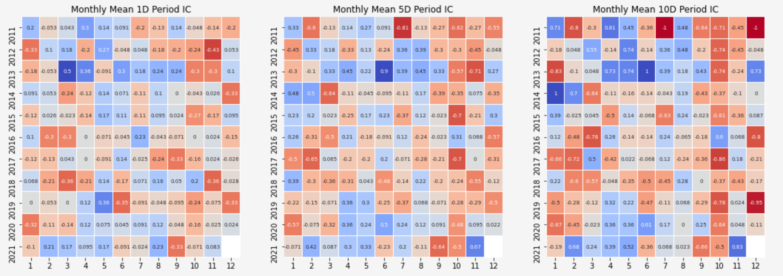
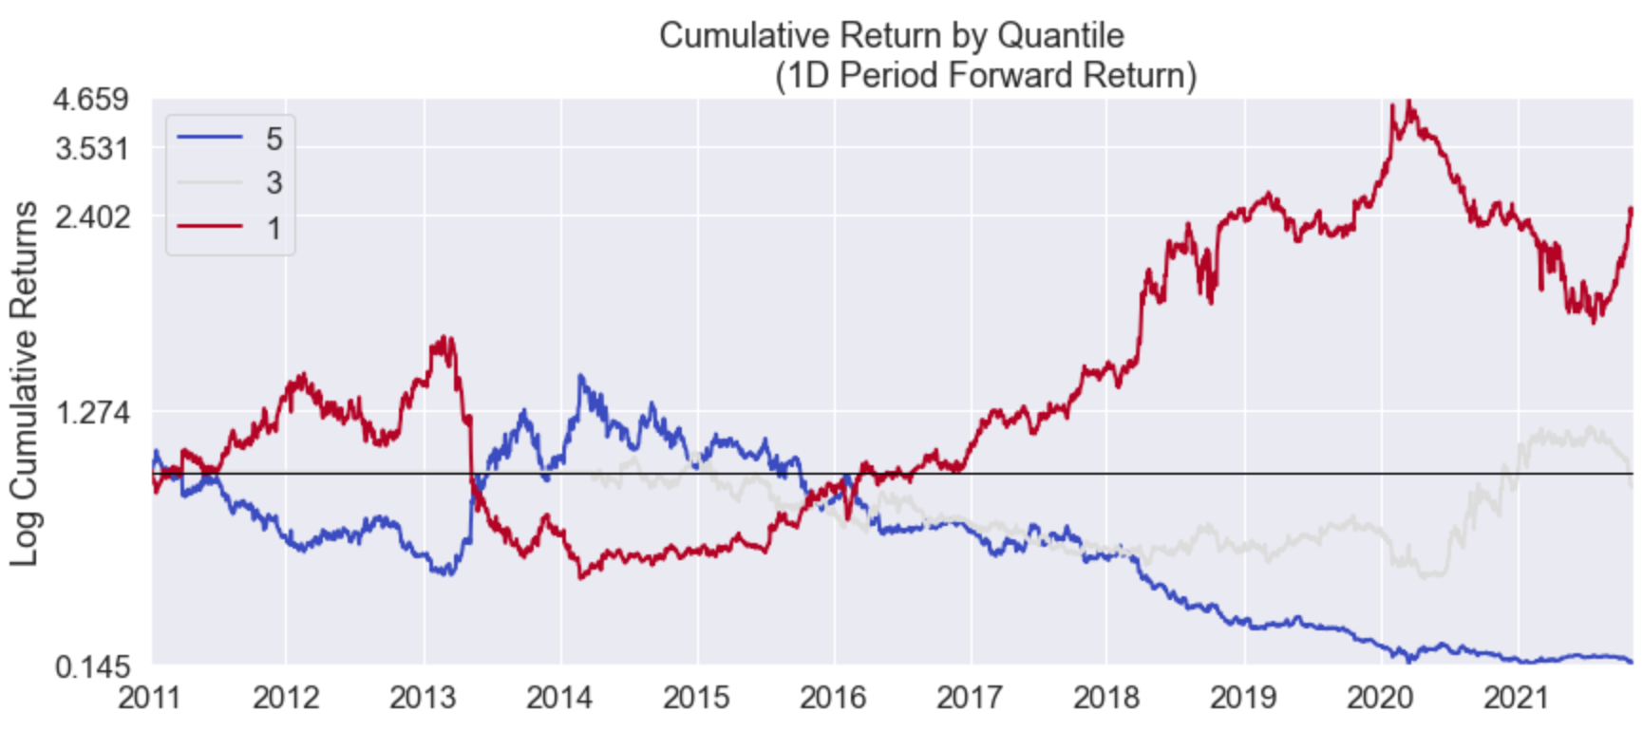
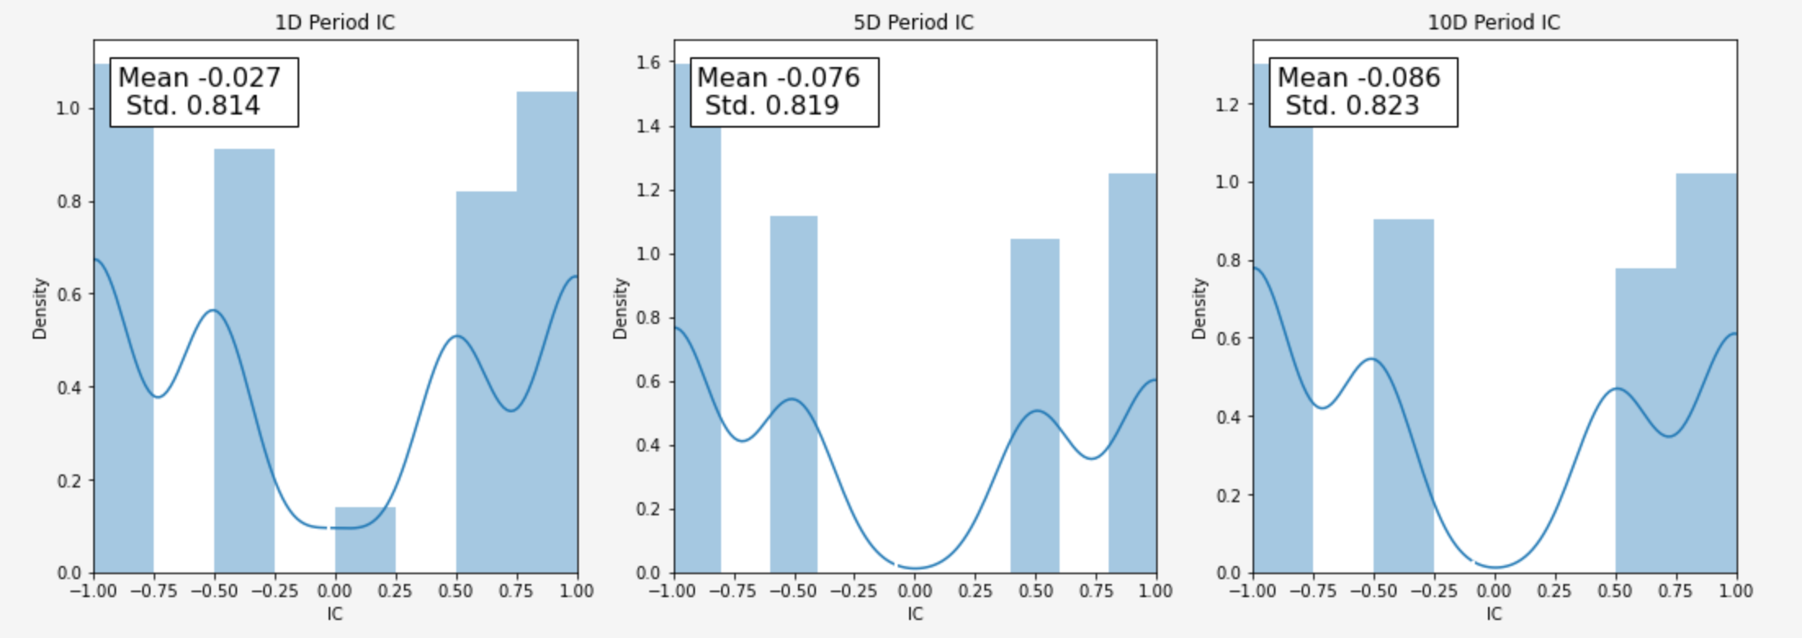
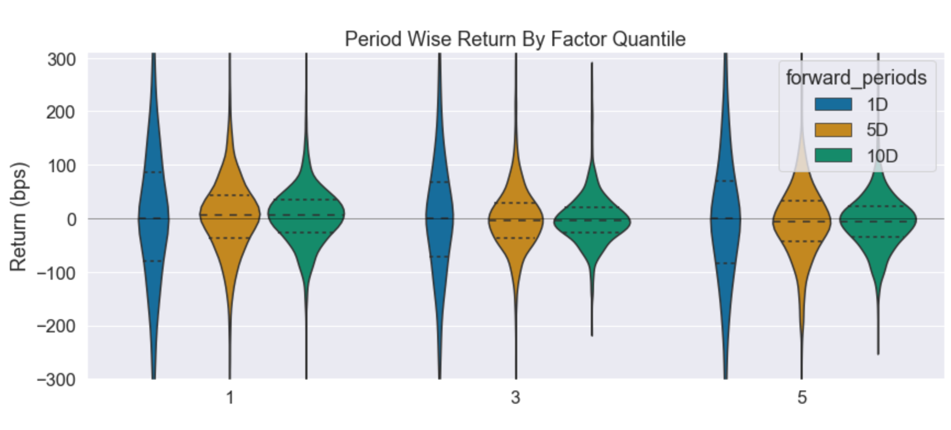
FACTOR PRETEST
NaN: fillna(0)
We fill the empty data with zero
Outliers:
We filter out the extreme values
Standardization:
We count the z-score
Transform to rank data:
Df = df.rank()

Slide 7
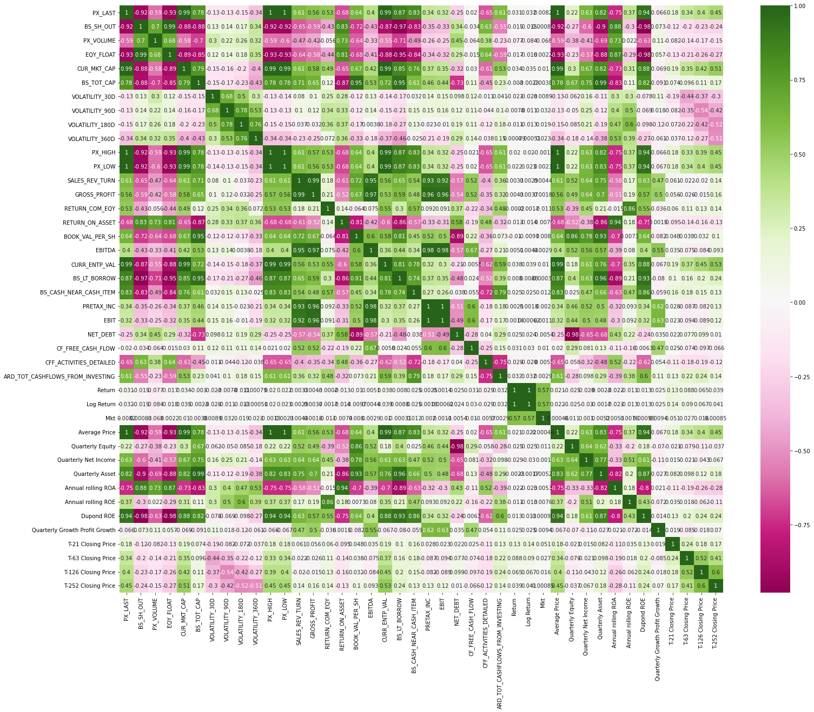
Factor Evaluation
Notes:
In order to select the ‘useful’ factors from those we initially found out, we make the correlation matrix of all the factors we find, as you can see in this slide. Then, we drop those factors which are highly correlated with other.

Slide 8
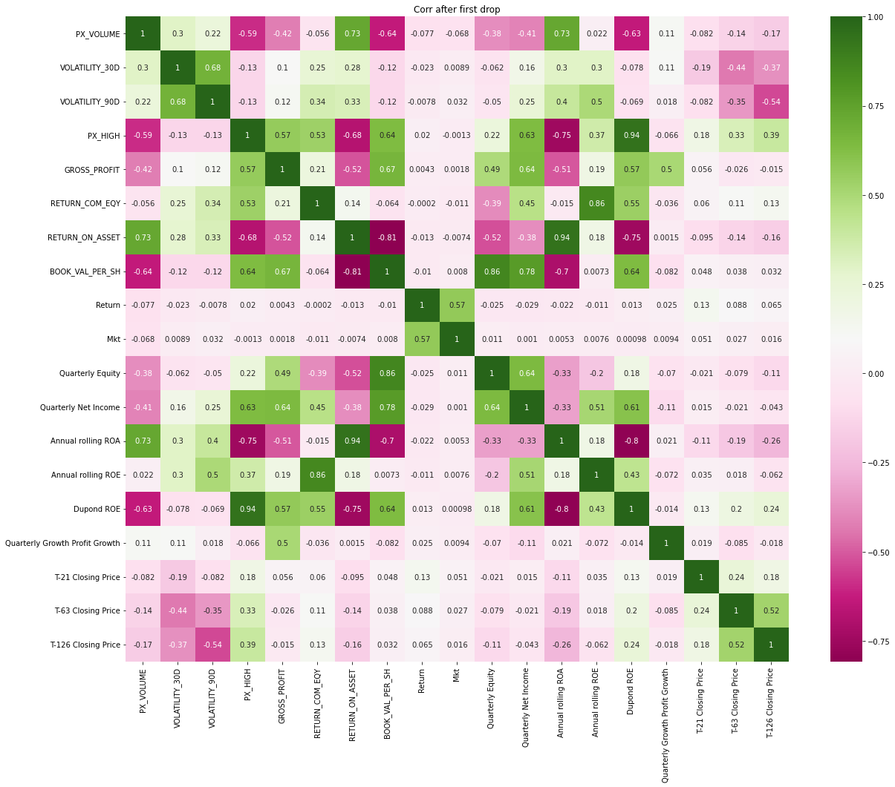
Factor Evaluation
Notes:
In order to select the ‘useful’ factors from those we initially found out, we make the correlation matrix of all the factors we find, as you can see in this slide. Then, we drop those factors which are highly correlated with other.

Slide 9
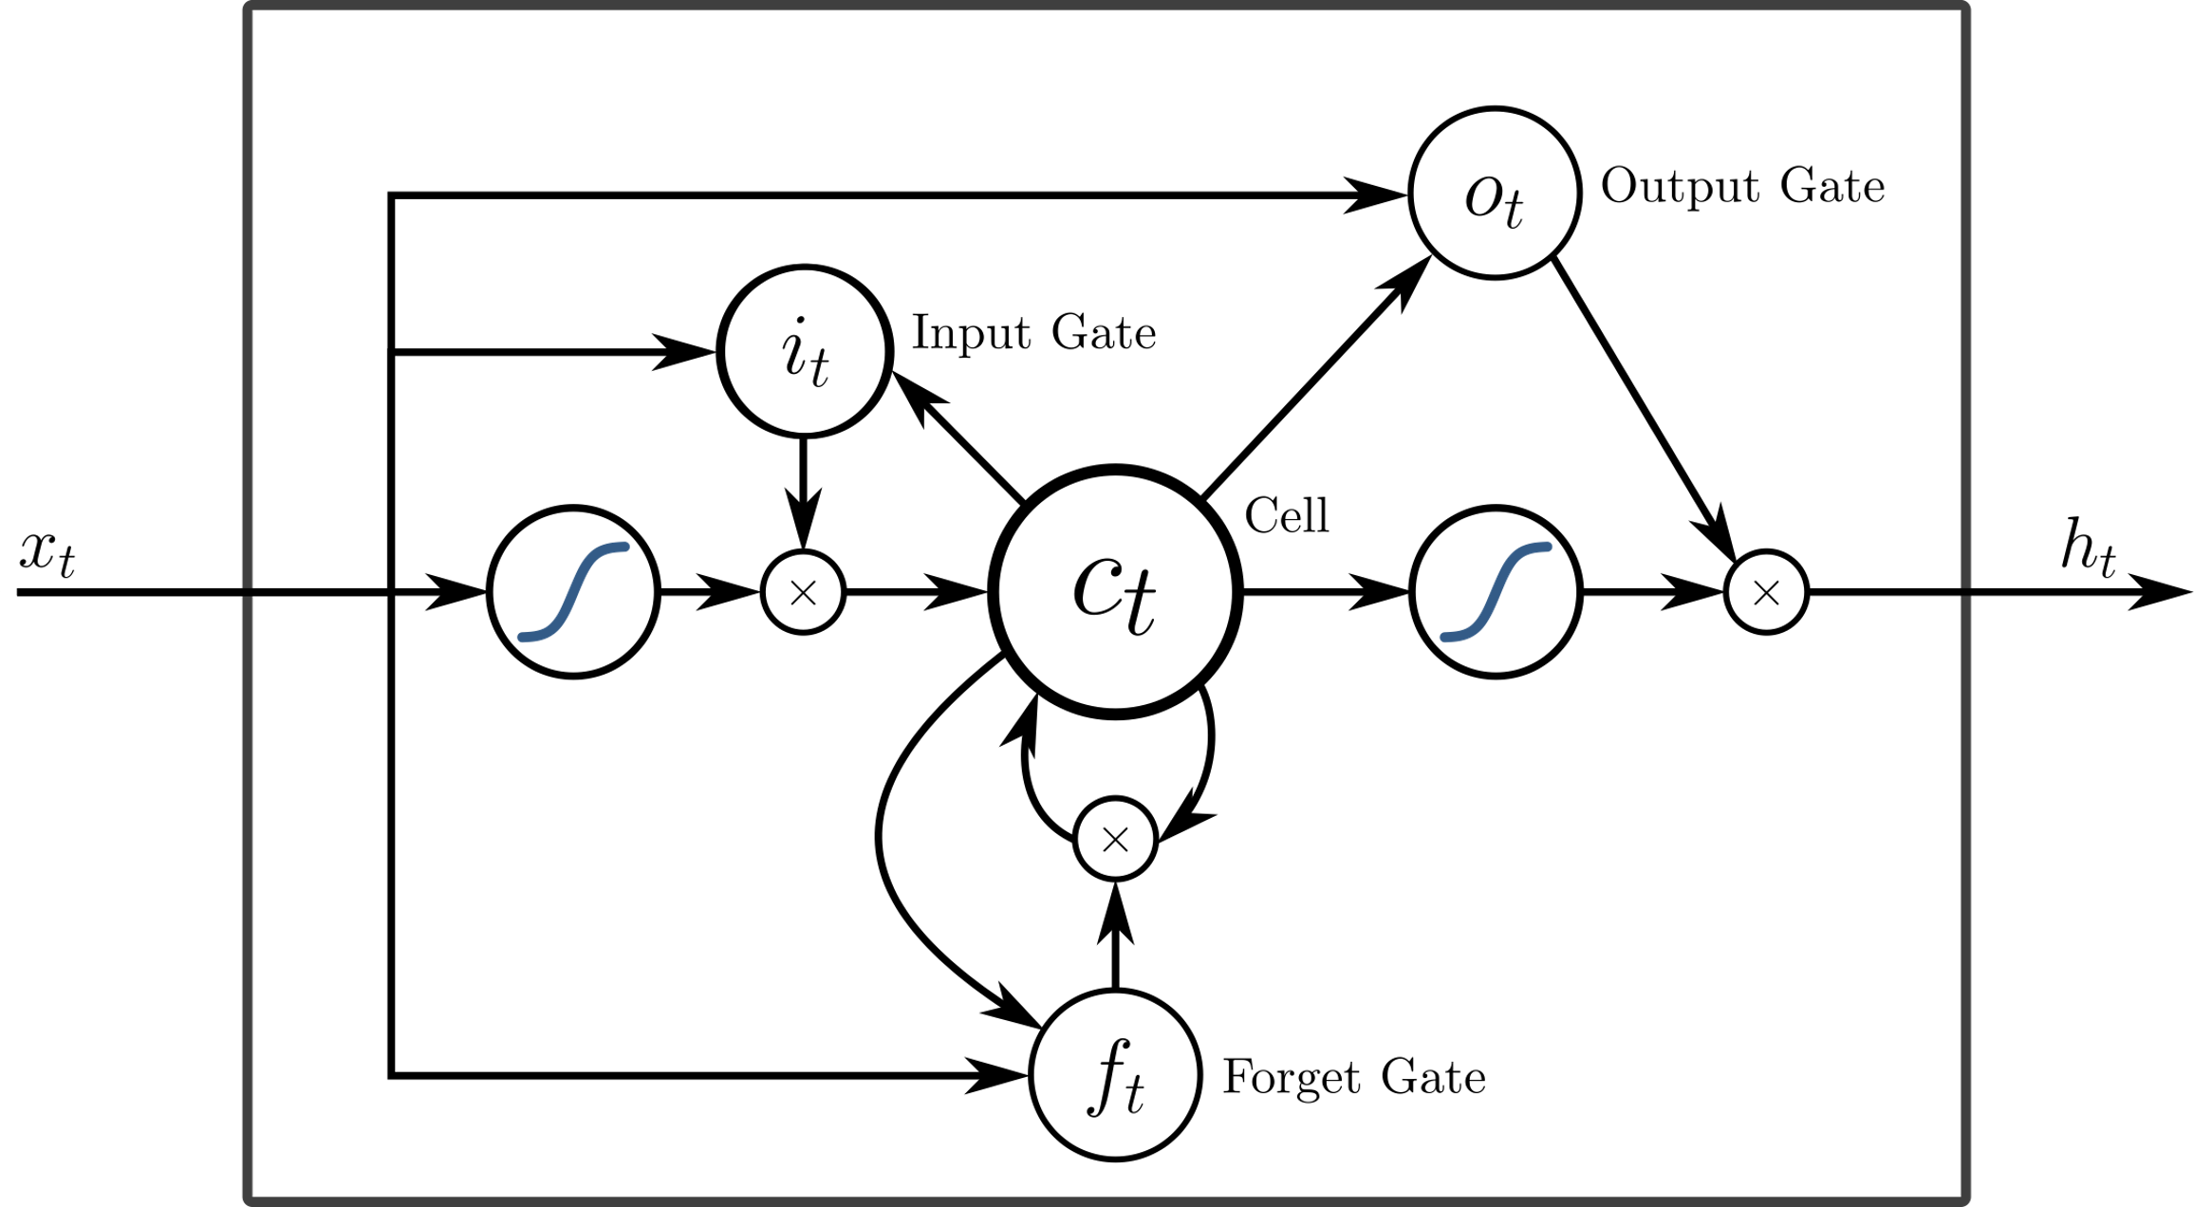

LSTM & CNN
LSTM
Long short-term memory (LSTM) is an artificial recurrent neural network (RNN) architecture used in the field of deep learning. Unlike standard feedforward neural networks, LSTM has feedback connections. It can process not only single data points (such as images), but also entire sequences of data (such as speech or video).
CNN
In deep learning, a convolutional neural network (CNN, or ConvNet) is a class of artificial neural network, most commonly applied to analyze visual imagery. They are also known as shift invariant or space invariant artificial neural networks (SIANN), based on the shared-weight architecture of the convolution kernels or filters that slide along input features and provide translation equivariant responses known as feature maps.
Notes:
In order to select the ‘useful’ factors from those we initially found out, we make the correlation matrix of all the factors we find, as you can see in this slide. Then, we drop those factors which are highly correlated with other.

Slide 10
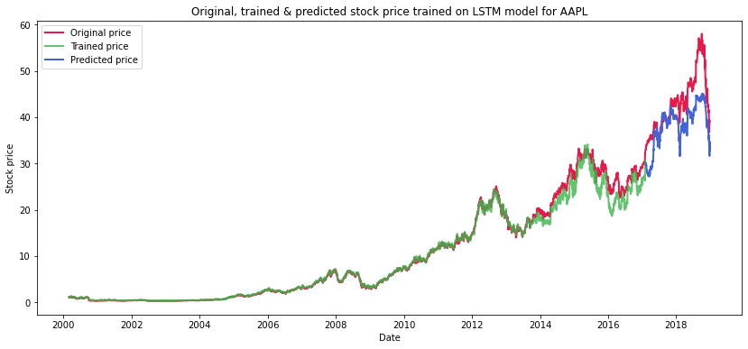
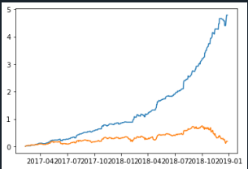
LSTM MODEL
 | Train | Test
Loss | 0.0152 | 0.1852
MSE | 0.0004 | 0.0428
Mae | 0.0152 | 0.1852
Notes:
In order to select the ‘useful’ factors from those we initially found out, we make the correlation matrix of all the factors we find, as you can see in this slide. Then, we drop those factors which are highly correlated with other.

Slide 11
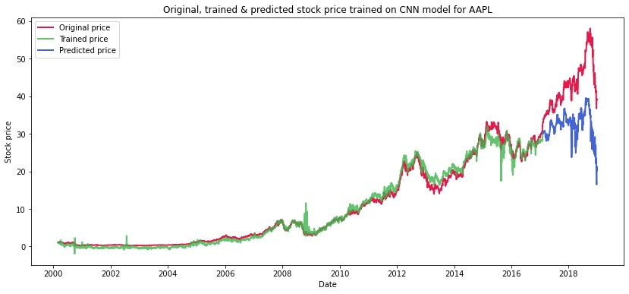
LSTM - CNN MODEL
 | Train | Test
Loss | 0.0152 | 0.1852
MSE | 0.0004 | 0.0428
Mae | 0.0152 | 0.1852
Notes:
In order to select the ‘useful’ factors from those we initially found out, we make the correlation matrix of all the factors we find, as you can see in this slide. Then, we drop those factors which are highly correlated with other.

Slide 12
Standardization
Dropping and filling None cells
Filtering extreme values with medians and ranges
Z-score
Ranking
PCA transformation
Notes:
Before, we put those factors into our model,

Slide 13
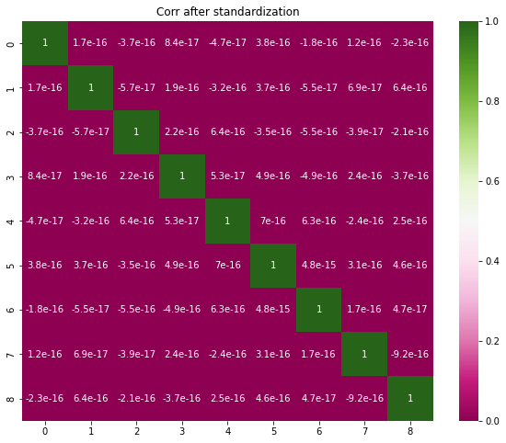
Correlations
after
standardization

Slide 14
Classification with Machine Learning
AdaBoost—Statistical Classification Meta-algorithm f
Decision Tree — Tree-Like Model in Decision Support
LightGBM —Gradient Boosting
Neural Network - MLP —Feedforward Artifical Neural Network
Random Forest —Multitude of Decison Tree
Supported Vector Machine —Suprevised Learning Model

Slide 15
Investment Strategy
Binary
Long and short
5-category
2 long, 1 hold and 2 short
Sub-dynamic 5-category
2 long, 1 hold and 2 short – positions vary

Slide 16
Model Scores
 | Training Set | Test Set
Adaboost | 0.4342 | 0.3598
Decision Tree | 0.4928 | 0.4405
LightGBM | 0.9981 | 0.3392
Neural Network - MLP | 0.4783 | 0.4332
SVM | 0.4751 | 0.4332
Random Forest | 1.0000 | 0.3789
Initial cash held: 10000
Initial stock value held: 0
Initial stock price: 25
Number of shares traded each time: 100

Slide 17
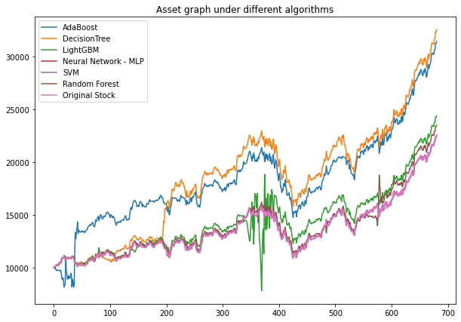
Model Scores
 | Final asset value | Percentage against Benchmark
AdaBoost | 31458.84 | 139.07%
Decision Tree | 32571.58 | 143.99%
LightGBM | 24406.64 | 107.89%
Neural Network - MLP | 22512.89 | 99.52%
SVM | 22518.34 | 99.55%
Random Forest | 23520.14 | 103.97%
Benchmark
AAPL Original Position | 22621.09 | 100.00%

Slide 18
Investment Simulation
Initial cash held: 10000
Initial stock value held: 0
Initial stock price: 25
Number of shares traded each time: 100

Slide 19
Conclusion - Machine Learning
Machine Learning may provide better returns
Right timing of decision ensures a long-term profit
Initial asset are important to portfolio return
Randomness of some algorithms varies the result greatly

Slide 20
Future improvements
Current model still relies on the stock heavily although signals are based on the market
Accuracy of models remains low despite reasonable returns
Reliance on the initial position
Universalism of the model

Slide 21
Thank you all for listening!
Questions?

Slide 22
Reference
Pg2: https://www.investopedia.com/terms/c/capm.asp
https://www.investopedia.com/terms/i/information-coefficient.asp
Pg3: https://finance.yahoo.com/quote/NFLX?p=NFLX&.tsrc=fin-srch

